Slide 1
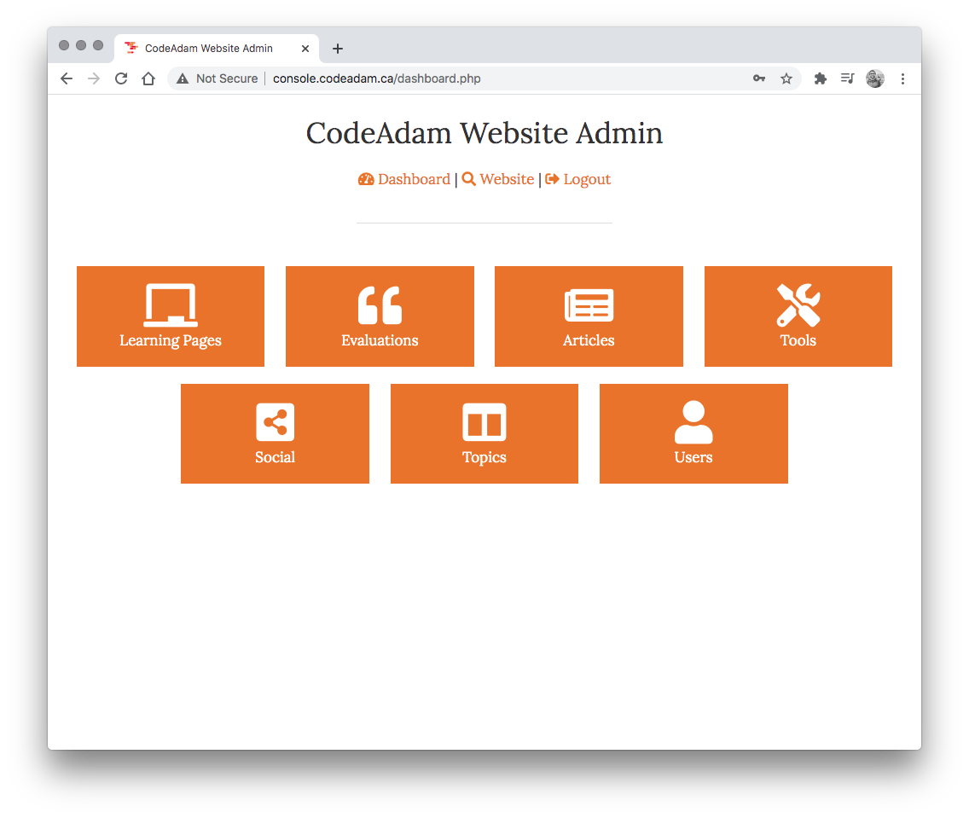
CMS Module
We are going to build an additional CMS module.

Slide 2
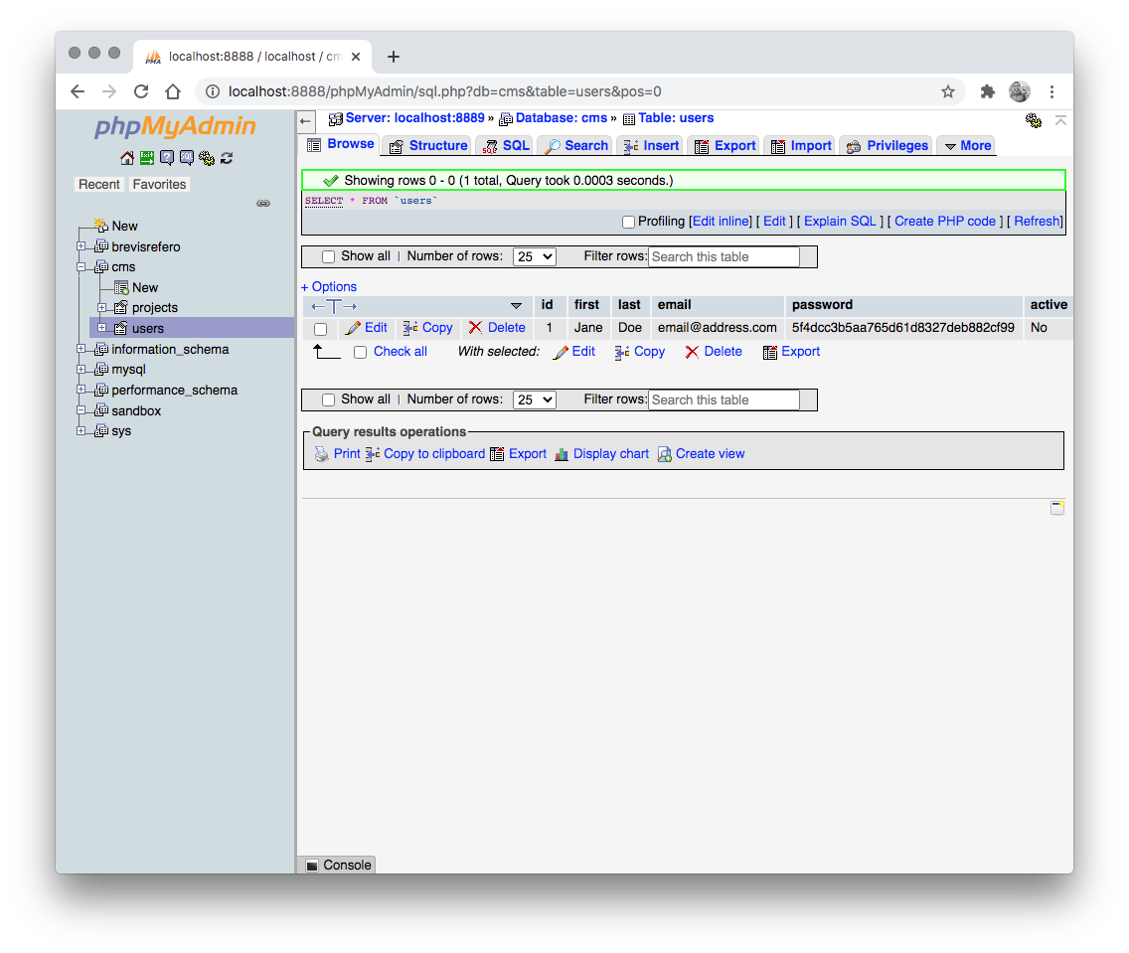
1: Database
We will start by creating a table to store skills:
id (int)
name (varchar)
url (varchar)
logo (longblob)
percent (tinyint)

Slide 3
2: Skills CRUD
LOGIN
Let’s build the list, add, ect, and delete to store skills:
DASHBOARD
MANAGE SKILLS
ADD SKILL
EDIT SKILL
DELETE SKILL

Slide 4
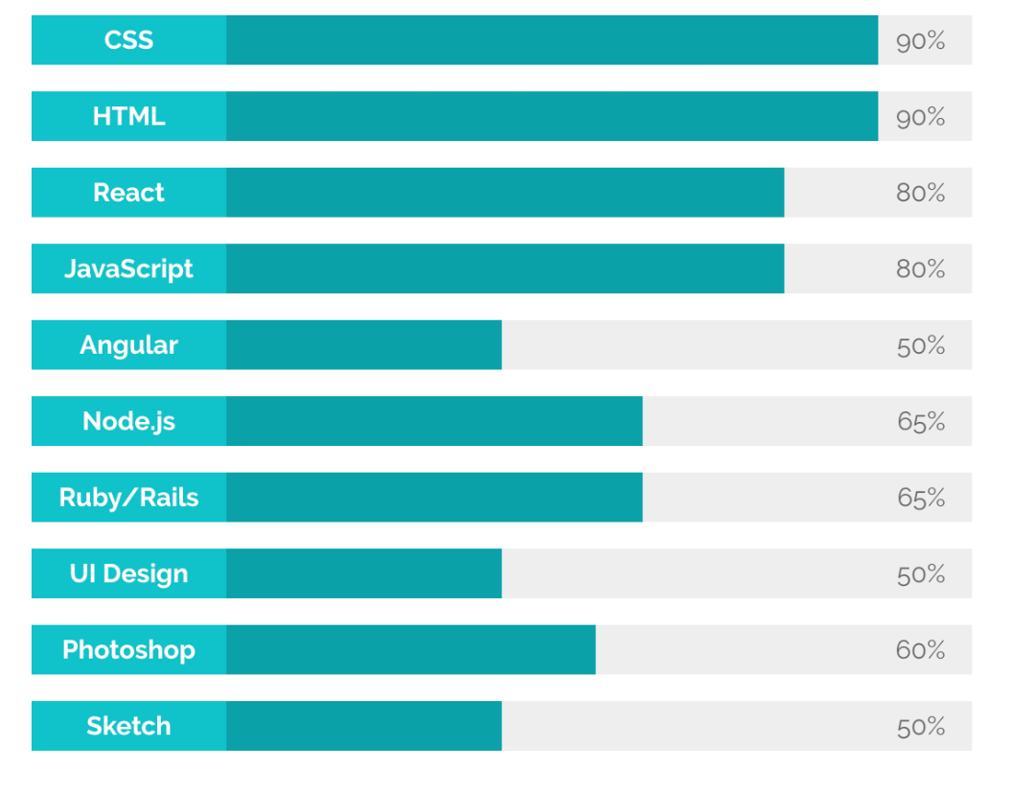
3: Front End
Build the frontend for skills:

Slide 5
Goals this Week
1. Design a basic portfolio
2. Create groups for your CMS assignment

